Slide 1
API Gateway Pattern
What Is an API Gateway
An API Gateway is basically an interface in which it receives calls and redirects to internal services(Microservices).
When building a large and complex system using the microservices architecture with multiple client apps, a good approach to consider is API Gateway Pattern.
This pattern provides a single entry-point for group(s) of microservices.
Therefore, the API Gateway sits between the client apps and the microservices. It acts as a reverse proxy, routing requests from clients to services.
It can also provide additional cross-cutting features such as Routing, Authentication, Service discovery, Logging .

Slide 2
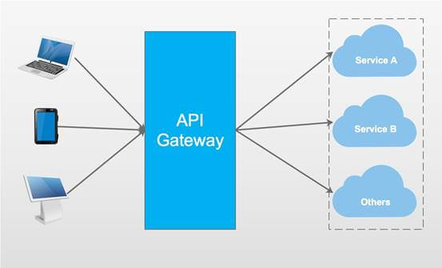
Building API Gateway Using Ocelot In ASP.NET Core

Slide 3
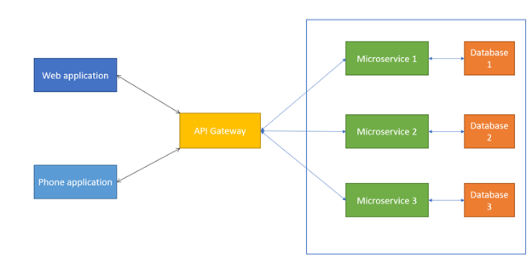
Building API Gateway Using Ocelot In ASP.NET Core

Slide 4
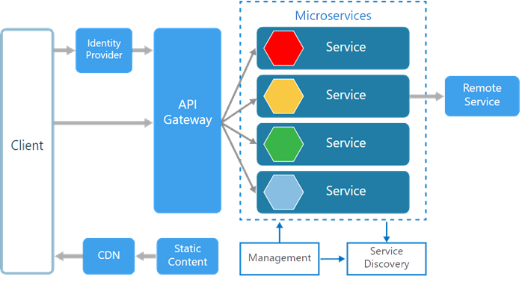
Building API Gateway Using Ocelot In ASP.NET Core

Slide 5
Building API Gateway Using Ocelot In ASP.NET Core
Ocelot
Ocelot is an API Gateway for .NET platform.
Ocelot is a .NET API Gateway.Ocelot is aimed at people using .NET running a micro-services / service orientated architecture who need a unified point of entry into their system.
Ocelot Features
Routing
Service Discovery with Consul & Eureka
Service Fabric
Authentication
Authorization
Caching
Load Balancing
Logging/Tracing/Correlation

